Slide 1
Dependency Injection
Travis Haley
https://bit.ly/2QjGSg1

Slide 2
What is a dependent?
Dependency or dependent means relying on something for support.

Slide 3
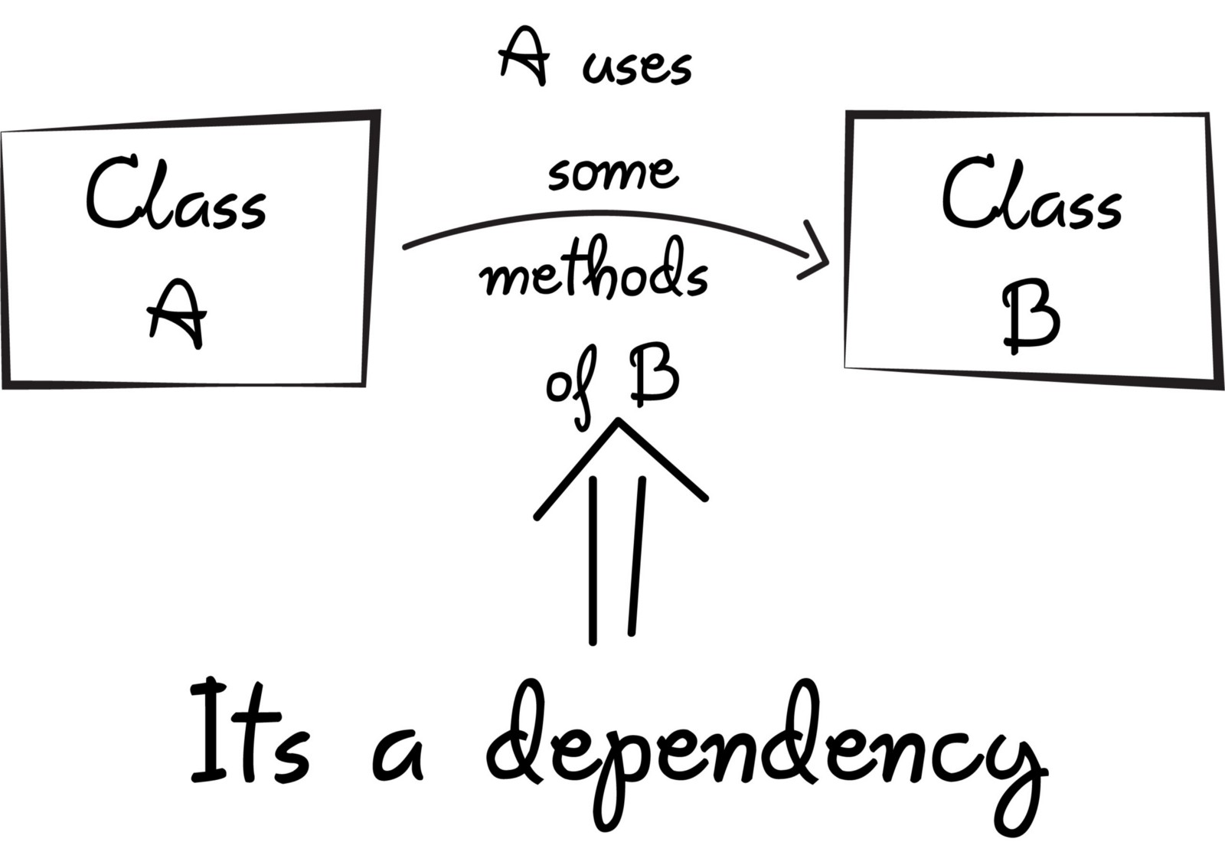
“New is glue”
Before we can use methods of other classes, we first need to create the object of that class (i.e. class A needs to create a “new” instance of class B).

Slide 4
What is Dependency injection?
Transferring the task of creating the object to someone else and directly using the dependency is called dependency injection.
You can think of DI as the middleman in our code who does all the work of creating the preferred object and providing it to the class.

Slide 5
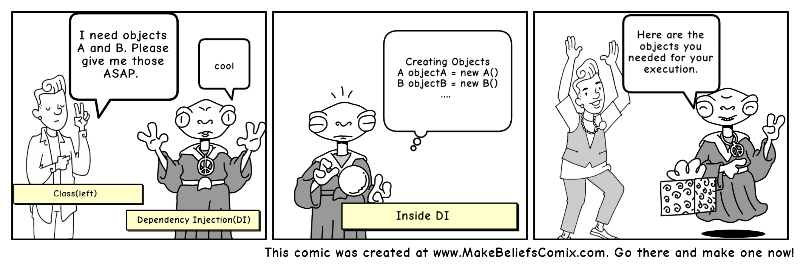

Slide 6
Types of dependency injection:
constructor injection: the dependencies are provided through a class constructor.
setter injection: the client exposes a setter method that the injector uses to inject the dependency.
interface injection: the dependency provides an injector method that will inject the dependency into any client passed to it. Clients must implement an interface that exposes a setter method that accepts the dependency.

Slide 7
Benefits of using DI:
Helps in Unit testing.
Boiler plate code is reduced, as initializing of dependencies is done by the injector component.
Extending the application becomes easier.
Helps to enable loose coupling, which is important in application programming

Slide 8
Disadvantages of DI:
It’s a bit complex to learn, and if overused can lead to management issues and other problems.
Many compile time errors are pushed to run-time.
Dependency injection frameworks are implemented with reflection or dynamic programming. This can hinder use of IDE automation, such as “find references”, “show call hierarchy” and safe refactoring.

Slide 9
Code Demo:

